Slide 1
Promoting good conduct in insurance distribution… “By promoting good regulation on conduct “ Nic De Maesschalck Director World Federation of Insurance Intermediaries WFII
IAIS Global Seminar London Panel on Conduct of Business 30 June 2017

Slide 2
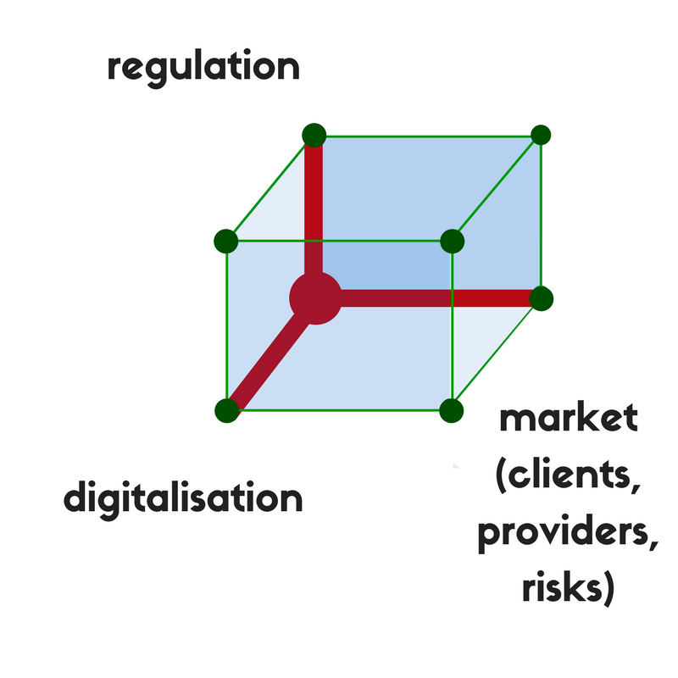
Our world …

Slide 3
IAIS ICP 18 Intermediaries
The Principle: The supervisor sets and enforces requirements for the conduct of insurance I ntermediaries, to ensure that they conduct business in a professional and transparent manner.
Standards:
18.1 The supervisor ensures that insurance intermediaries are required to be licensed.
18.2 The supervisor ensures that insurance intermediaries licensed in its jurisdiction are subject to ongoing supervisory review.
18.3 The supervisor requires insurance intermediaries to possess appropriate levels of professional knowledge and experience, integrity and competence.
18.4 The supervisor requires that insurance intermediaries apply appropriate corporate governance.
18.5 The supervisor requires insurance intermediaries to disclose to customers, at a minimum:
the terms and conditions of business between themselves and the customer;
the relationship they have with the insurers with whom they deal; and
information on the basis on which they are remunerated where a potential conflict of interest exists.
18.6 The supervisor requires an insurance intermediary who handles client monies to have sufficient safeguards in place to protect these funds.
18.7 The supervisor takes appropriate supervisory action against licensed insurance intermediaries, where necessary, and has powers to take action against those individuals or entities that are carrying on insurance intermediation without the necessary license.

Slide 4
Implementation
With realism and proportionality,
eye for administrative burden and
taking into account the following points:

Slide 5
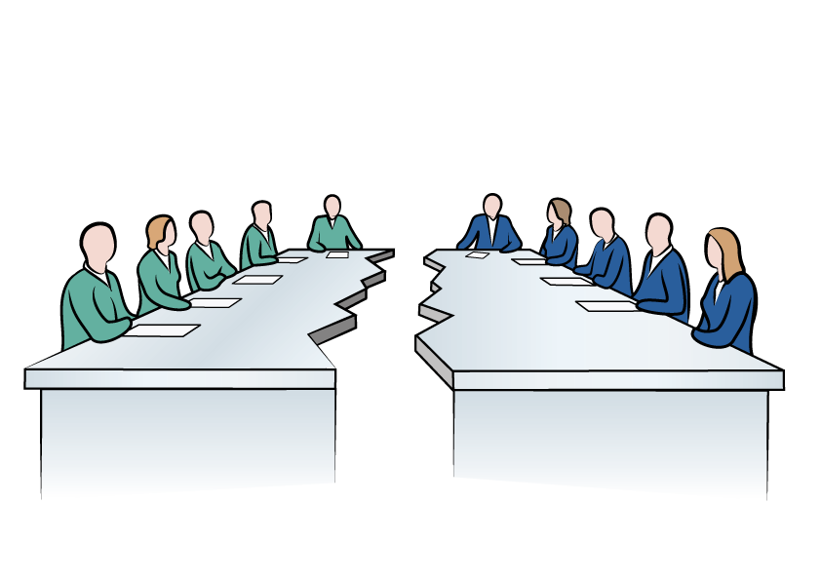
Implementation
Insurance Based Investment Products vs Non-Life/pure life
Two different worlds, do not copy-paste!

Slide 6
Implementation
Commercial line customers
vs
Private consumers.

Slide 7
Implementation
The level playing field should be observed.

Slide 8
Implementation
Providers
and
Intermediaries
Their contractual relations should not be regulated.

Slide 9
Implementation
Too much detailed regulation may be:
→barrier to innovation and development;
not to the wish of the consumers.
Barrier to fluid process

Slide 10
Implementation
Time for regulatory pause
Time for legal stability.

Slide 11
Implementation
Conduct of Business:
Promotor of confidence and enhancement of reputation?
Supervisors and regulators:
Co-promotors of confidence

Slide 12
World Federation of Insurance intermediaries
Founded in 1999
Sole representative of insurance intermediaries with international institutions
5 Regional Chapters
100 national associations of insurance agents and brokers in over 80 countries across the world.

Slide 13
Promoting good conduct in insurance distribution… “By promoting good regulation on conduct “ Nic De Maesschalck Director World Federation of Insurance Intermediaries WFII
IAIS Global Seminar London Panel on Conduct of Business 30 June 2017

