Slide 1
Challenges in implementing Risk Based Supervision
IAIS Annual Conference
Asunción, November 2016

Slide 2
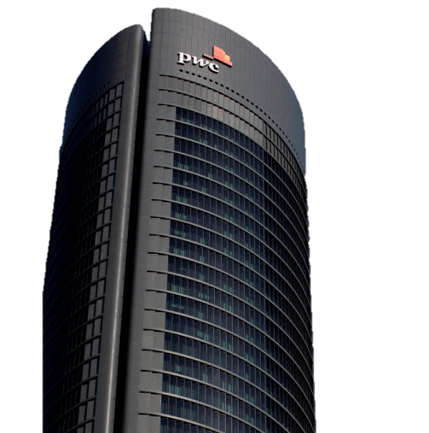
Content
Introduction
Preface: Mirror, Mirror
The beginning: The Mission
Effective Supervision: Catch me if you can
Implementation by the business: Reality Bites
ORSA as an example: Twins
Epilogue: Frozen
Final piece of advice outside Holllywood

Slide 3
I. Introduction

Slide 4
Challenge, what challenge?

Slide 5
II. Preface: Mirror, Mirror

Slide 6
II. Preface: Mirror, Mirror (2012)
Alignment of the regulatory framework with the business reality: RISK
3 Pillars instead of 7 dwarves
Are there poisoned apples?

Slide 7
III. The beginning: The Mission

Slide 8
III. The beginning: The Mission (1986)
Need to involve all stakeholders
Need to explain the new regime
The Concentration question

Slide 9
IV. Effective supervision: Catch me if you can

Slide 10
V. Effective supervision: Catch me if you can (2002)
Learning by doing
Need to change
The “If it ain´t broke don´t fix it” dilema
The “Money, Honey” soundtrack
The “Strong supervision is good for you” paradox

Slide 11
V. Implementation by the business: Reality bites

Slide 12
VI. Implementation by the business: Reality bites (1994)
Learning by doing (as well)
Can we make it easier?
A Smart KPI (for a change): Cost vs. investment

Slide 13
VI. ORSA as an example: Twins

Slide 14
VI. ORSA as an example: Twins (1988)
Are they really the same?
How do I factor that in?
The temptation: different requirements
The right choice: same requirements, different implementation

Slide 15
VII. Epilogue: Frozen

Slide 16
VII. Epilogue: Frozen (2013)
Moving to a risk based system: From Hans to Kristoff

Slide 17
VIII. Final piece of advice outside Hollywood

Slide 18
VIII. Final piece of advice outside Hollywood

Slide 19
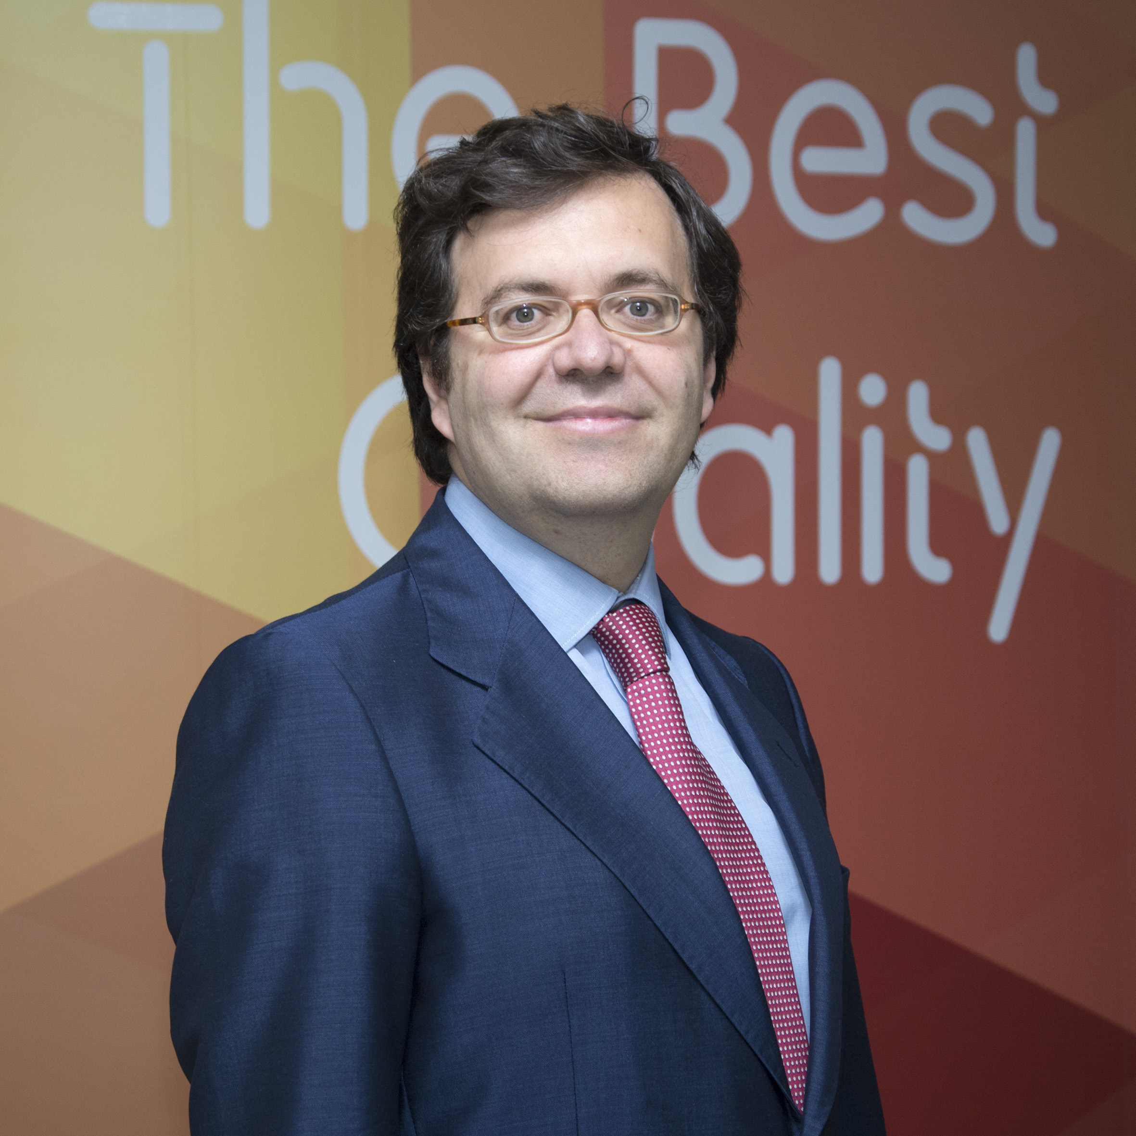
Thank you, Muchas gracias!
Partner Financial Services
Carlos Montalvo Rebuelta
Partner Financial Services
PwC Spain Phone: +34 915684278 Mobile: +34 628779707 carlos.montalvo.rebuelta@es.pwc.com
PwC ayuda a organizaciones y personas a crear el valor que están buscando. Somos una red de firmas presente en 157 países con mas de 208.000 profesionales comprometidos en ofrecer servicios de calidad en auditoría, asesoramiento fiscal y legal y consultoría. Cuéntanos qué te preocupa y descubre cómo podemos ayudarte en www.pwc.es
© 2016 PricewaterhouseCoopers Auditores, S.L. Todos los derechos reservados. “PwC” se refiere a PricewaterhouseCoopers Auditores, S.L. , firma miembro de PricewaterhouseCoopers International Limited; cada una de las cuales es una entidad legal separada e independiente.

